Slide 1


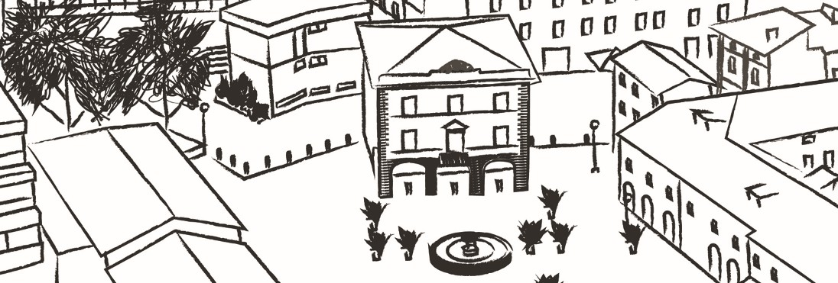
Educare
Project “BEYOND - Rural Communities pushing BEYOND COVID-19” ref: 101091100
Presenters:
Eddy Galeotti - Giovanni Mazzoli
Date: 14/11/23

Slide 2
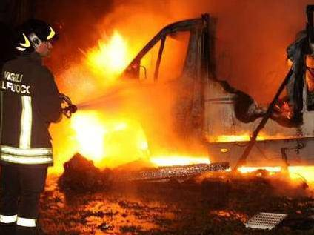
October 2011
Two young boys of 14 and 18 died burned while spending the night after disco in the family’s camper.
A tragedy like this one never occurred in our town.
Citizens needed to meet togheter to talk about this tragedy trying to understand it.
Citizens began to think about young people living in Cavriago, they needed to understand them and know each other.
While talking about this tragedy we understood we need the help of the whole comunity to accompany the growth of new generations.

Slide 3
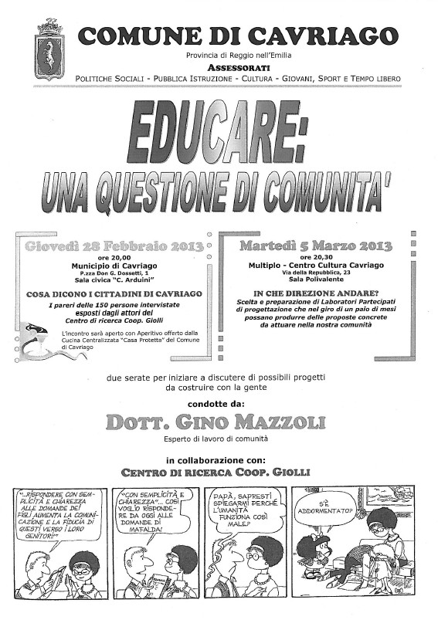
Over 300 people took part in the meetings: parents, teachers, policemen, doctors, social workers, catechists,coaches, merchants.
During the meetings we understood:
Education is not only concerning the families but the whole town;
The topic concern not only istitutions but mainly the comunity;
We need to work togheter with our girls and boys and not on them;
We need to share the same goals.
We need to bild educational alliances.

Slide 4
After this work some people decided to dedicate themselves to young generation and in particular on:
Bullying
Cultural diversity
Emotions
Meeting places
Gaps (gendergap, digitalgap…)
On these topics the group decided to:
Promot studies
Immaginate solutions to problems
Plann actions
do foundraising

Slide 5
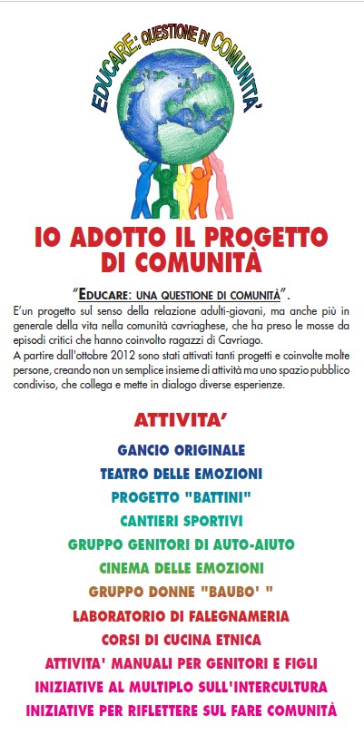
During these 10 years the group planned and promoted over 15 activities for schools, for families, in the sports, for free time, braceing fragilities.
Beside you can see some of these activites as:
Peer 2 peer homeworks activities
Emotional theater
Digital workshops
Self helping group for parents
Cineforum
Whorkshops against gender violence
Carpentry and ethnic cuisine workshops
Stories and experience from the world
Training for teachers

Slide 6
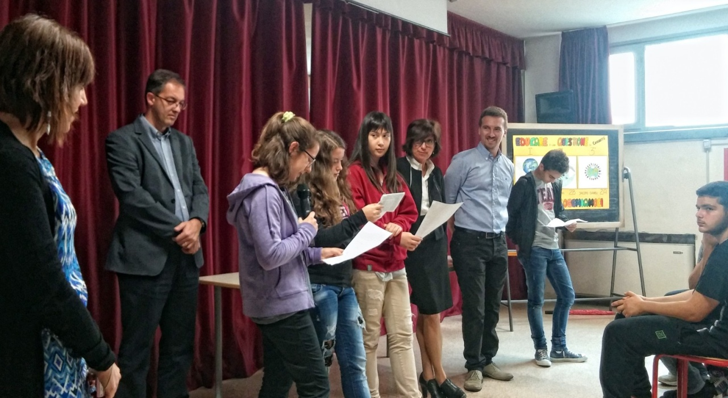

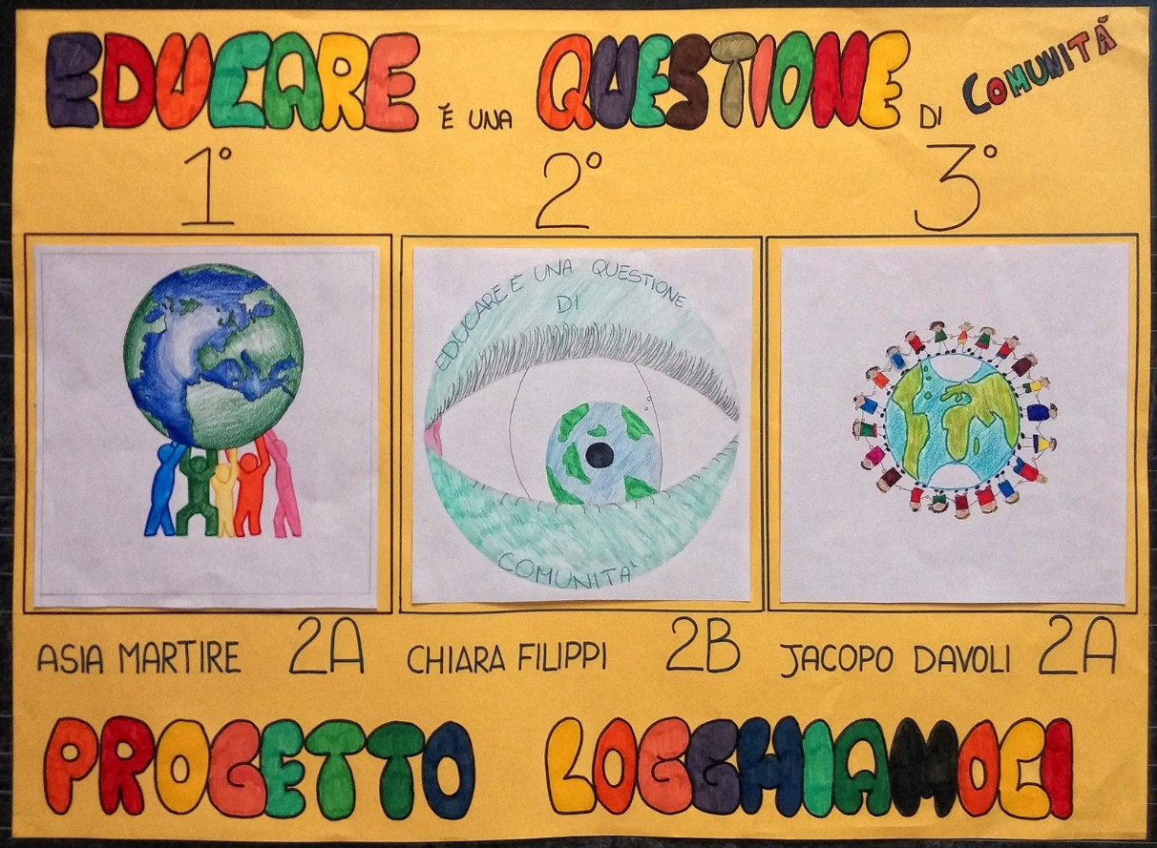
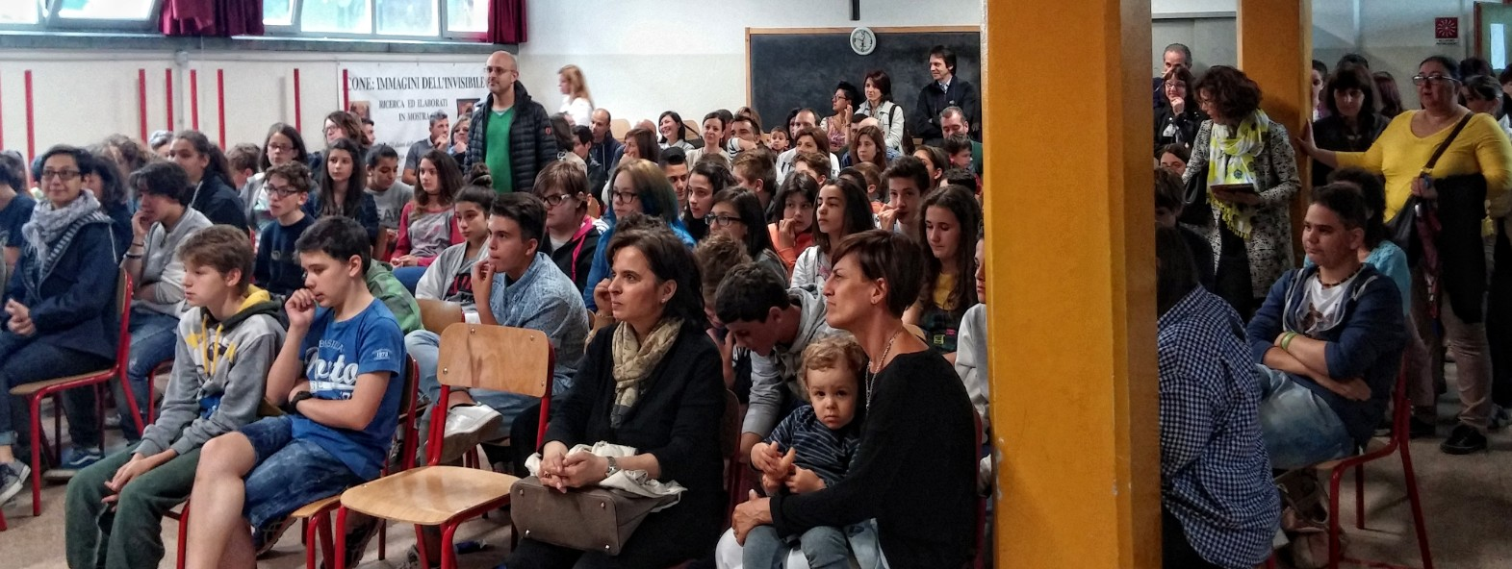

Slide 7
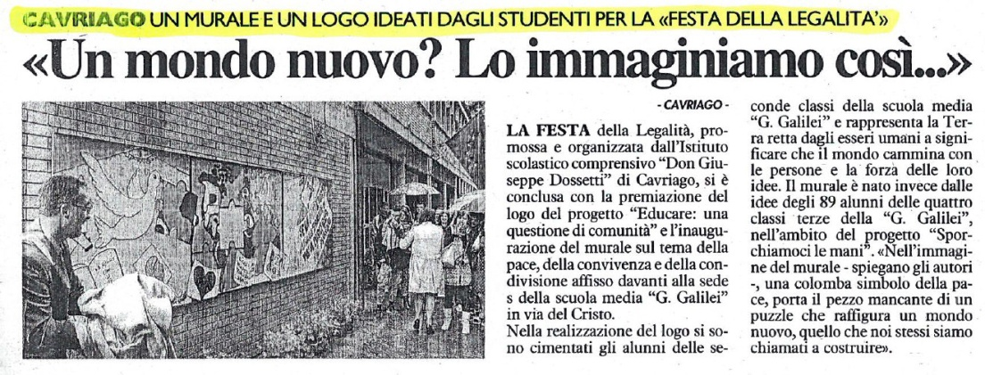
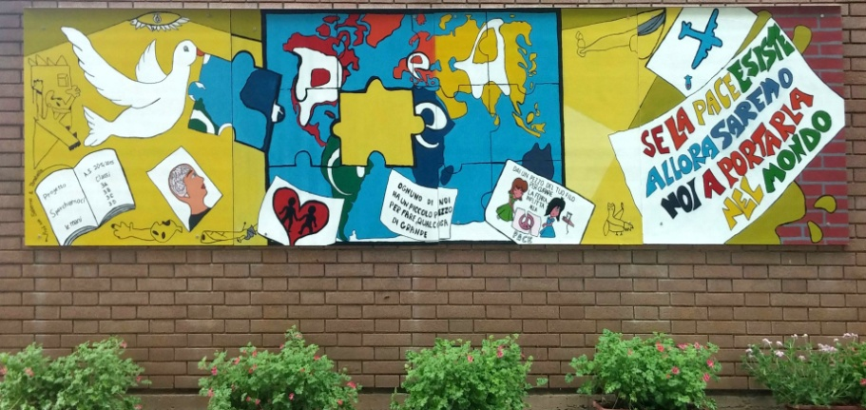
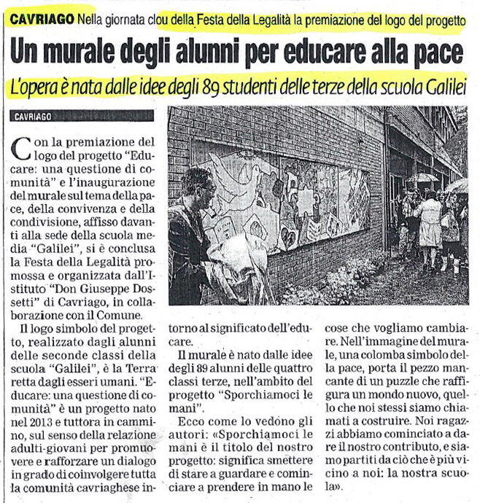

Slide 8



Slide 9
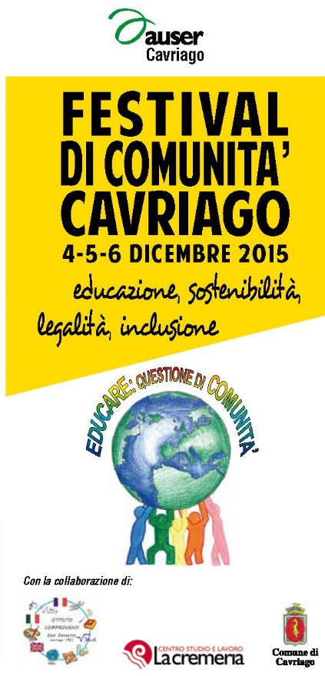
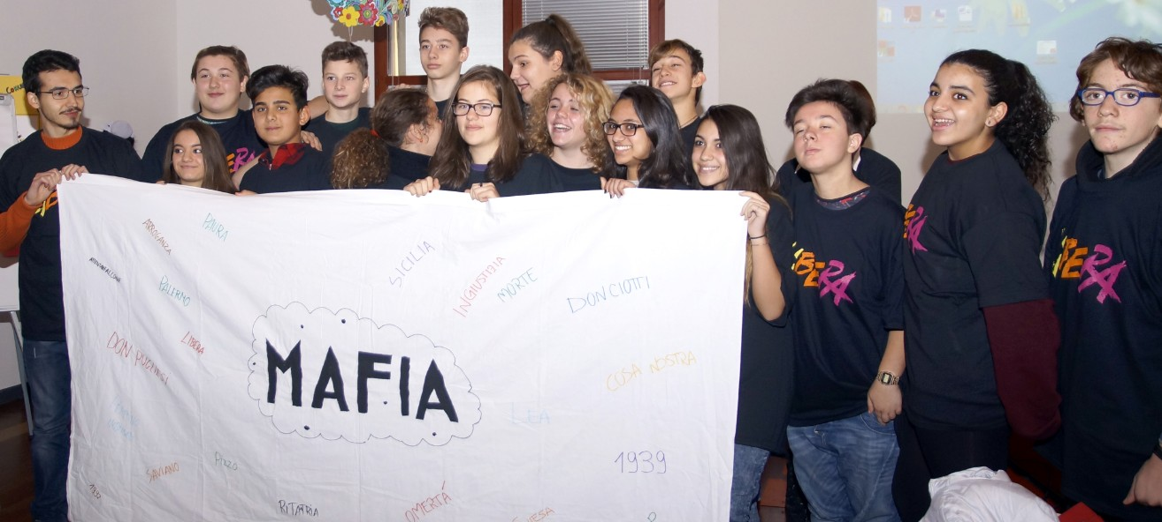
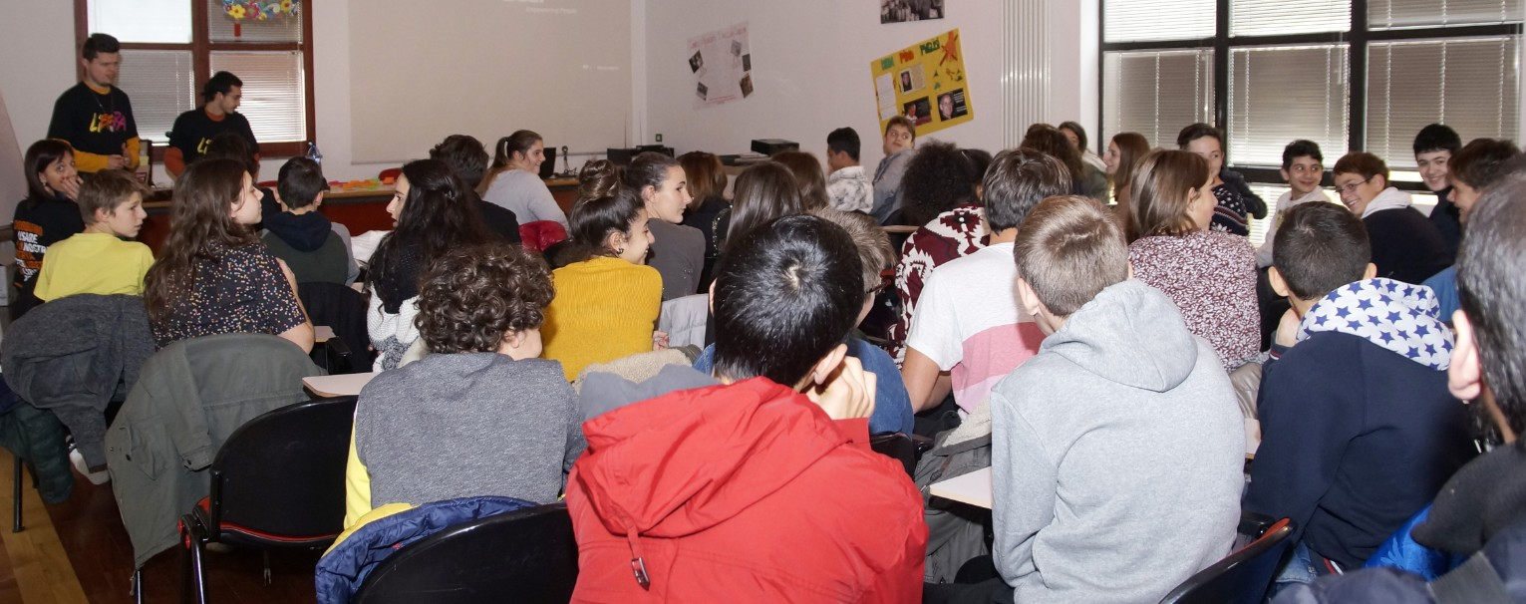

Slide 10
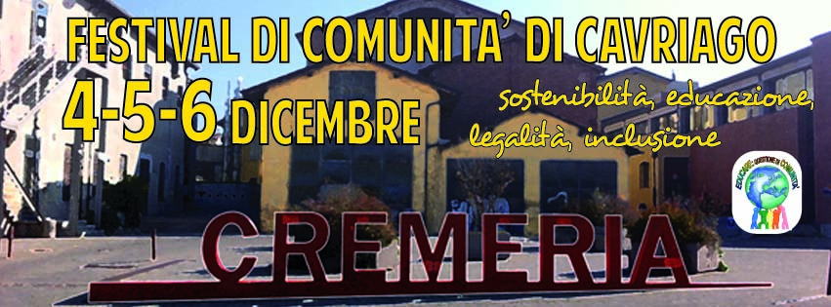
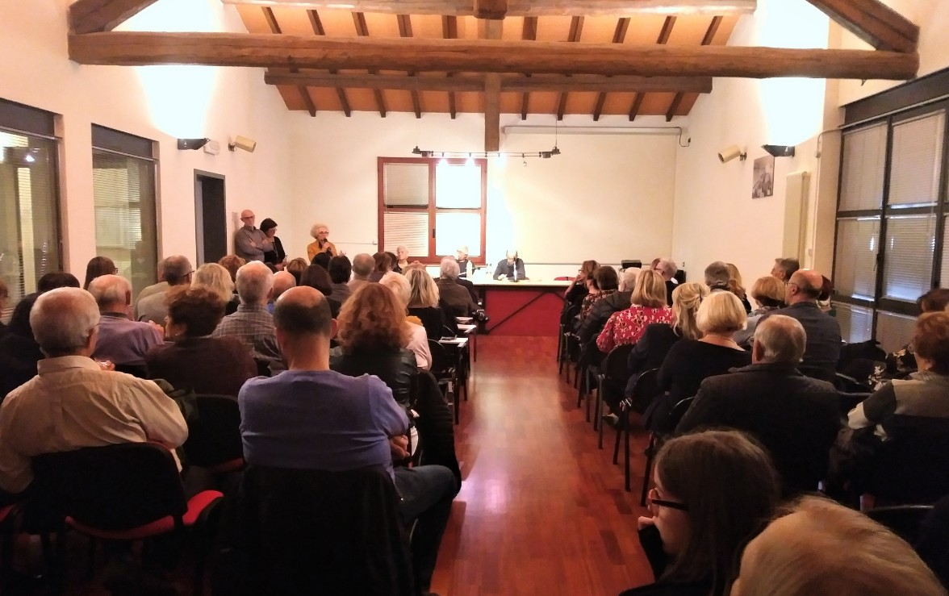
But sometimes the unexpected happens…..

Slide 11

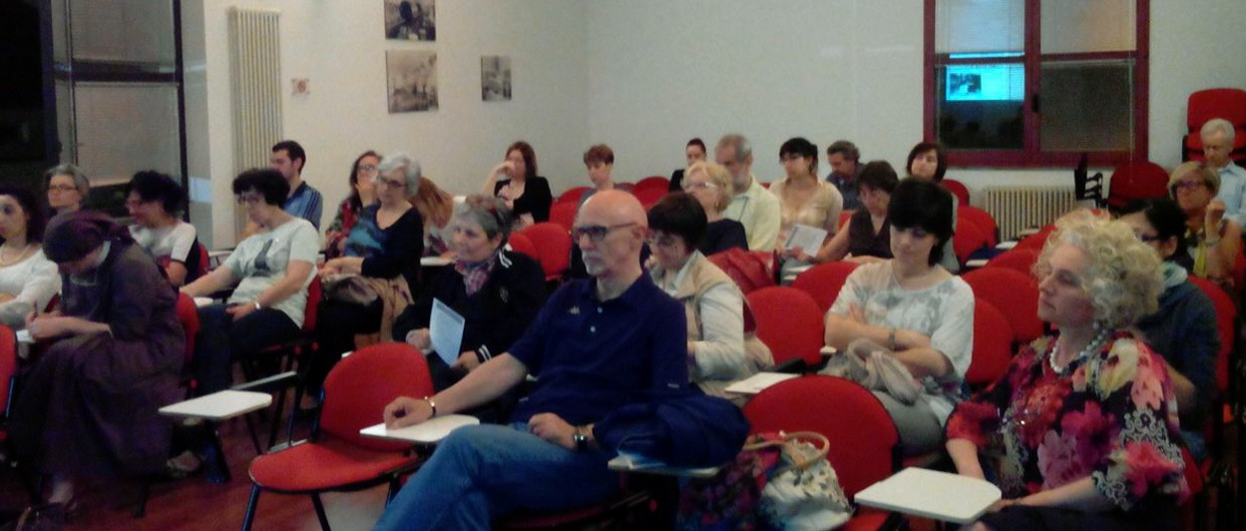
Day by day the group understood that they could be a resource for the comunity not only on educational topics.
They began to organize the Comunity Festival to involve the whole citizens on diffrent topics as for example:
Cohousing
Lawfullness
Diasability
Cooperation
And many others

Slide 12
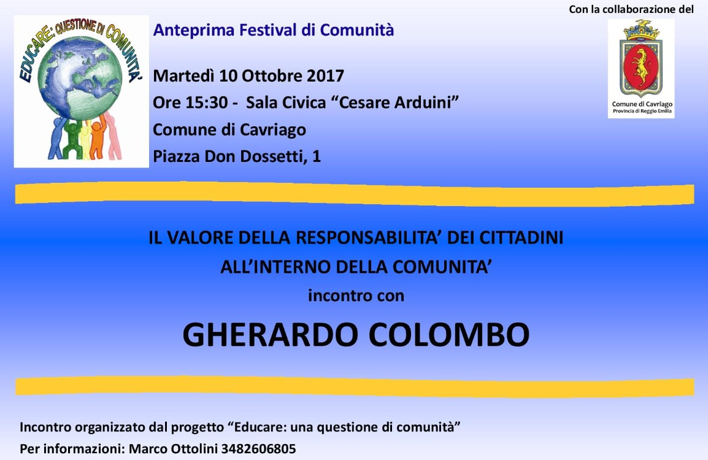
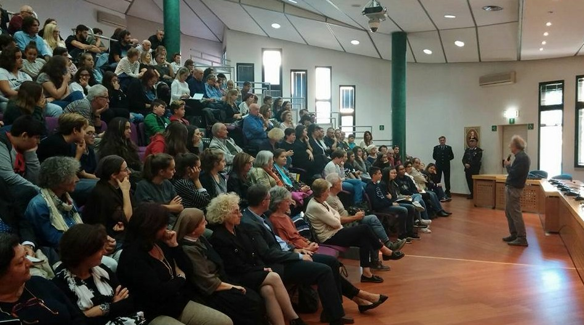

Slide 13
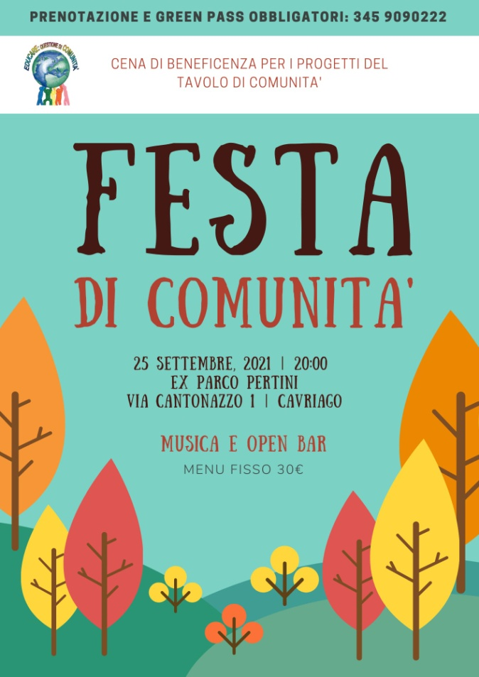


Slide 14
How does it work?
The group is indipendent from the town council and everyone can join it at any time. The group is spontaneos and it’s not legally constituted. The group builds partnership whit different istitution or subjects involved in our town’s social life. The group does foundraising in order to promote its own activities.
Which challenges for the future?
The most important challenge we have to face nowaday are:
Encourage new members to join the group
Face the post pandemic phase supporting young people who are suffering a lot
Legal constitution opportunity or problem?

Slide 15
THANK YOU FOR YOUR KIND ATTENTION

